Slide 1
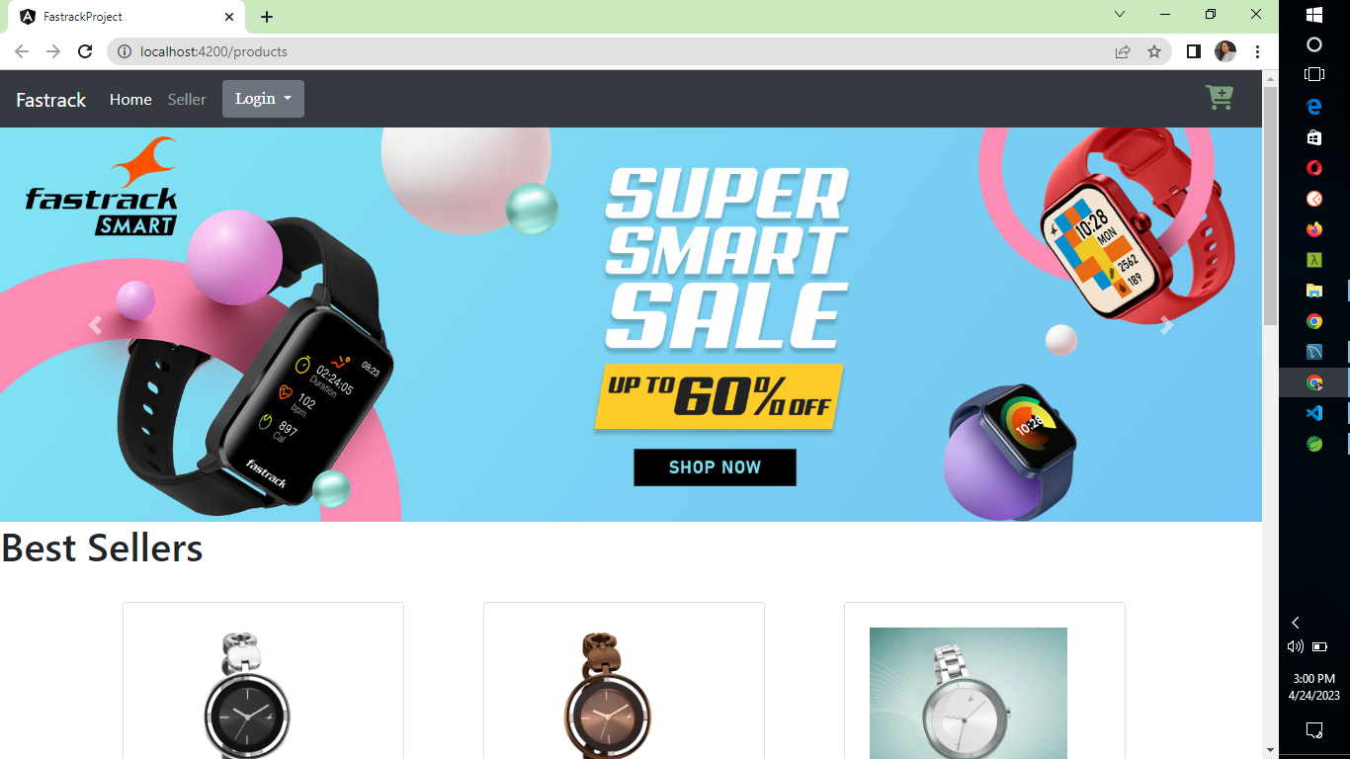
HOME PAGE

Slide 2
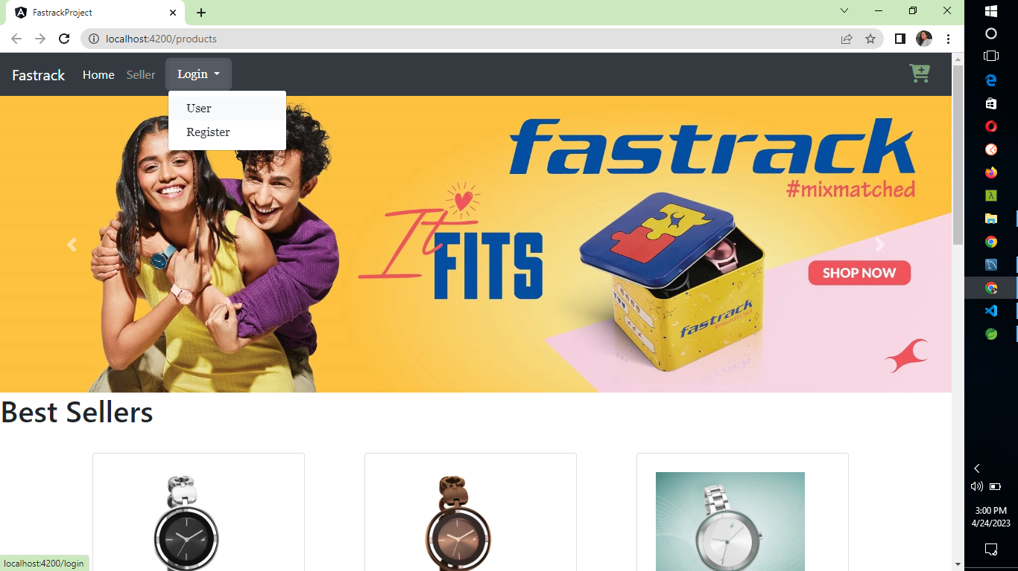
USER LOGIN AND REGISTER ICON

Slide 3
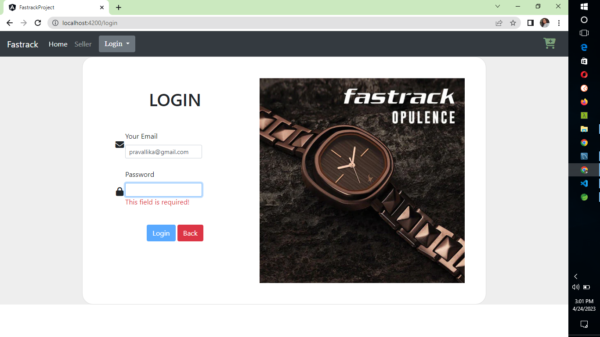
Login page

Slide 4
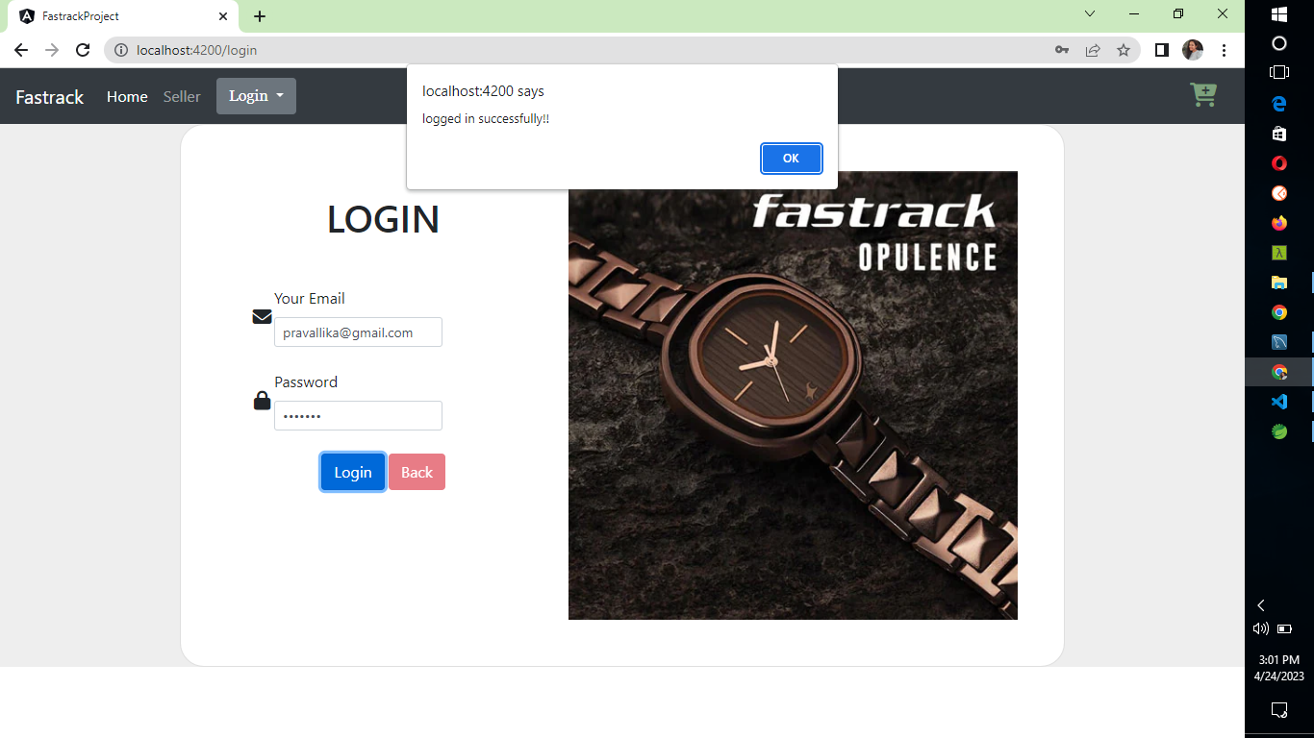
Successful login

Slide 5
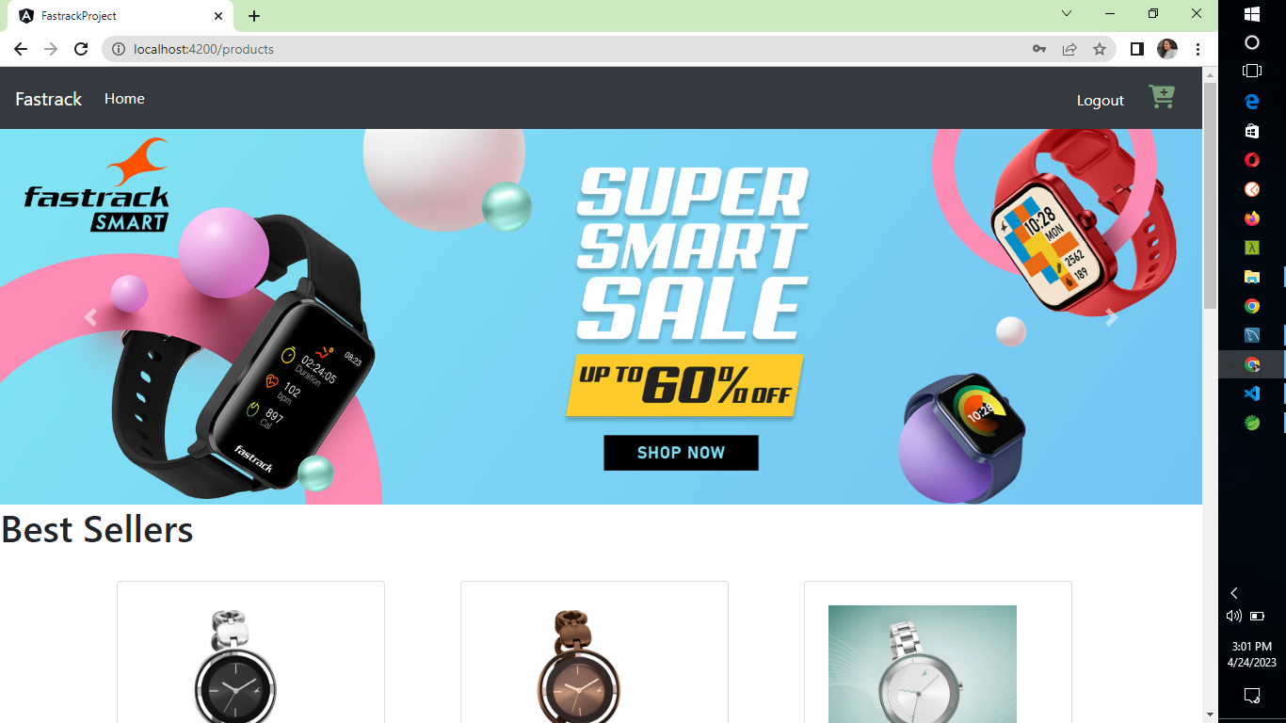
HOME PAGE AFTER LOGIN WITH LOGOUT BUTTON

Slide 6
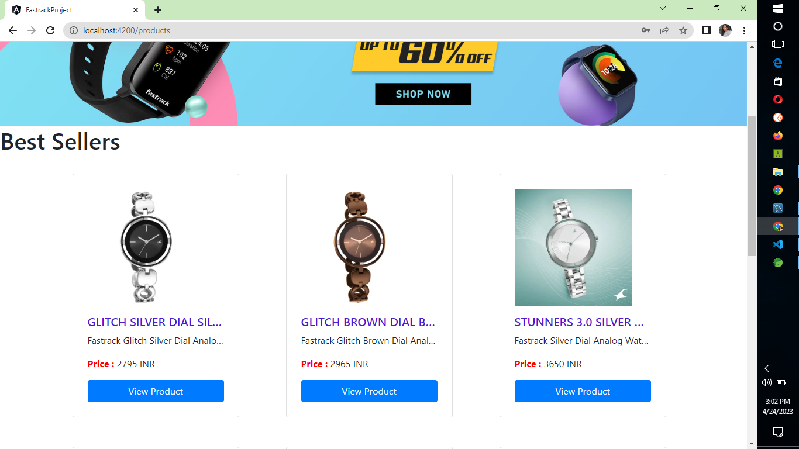
PRODUCT VIEW(ONLY FOR REGISTERED USERS) IF NOT LOGGEDIN REDIRECTS TO LOGIN PAGE.

Slide 7
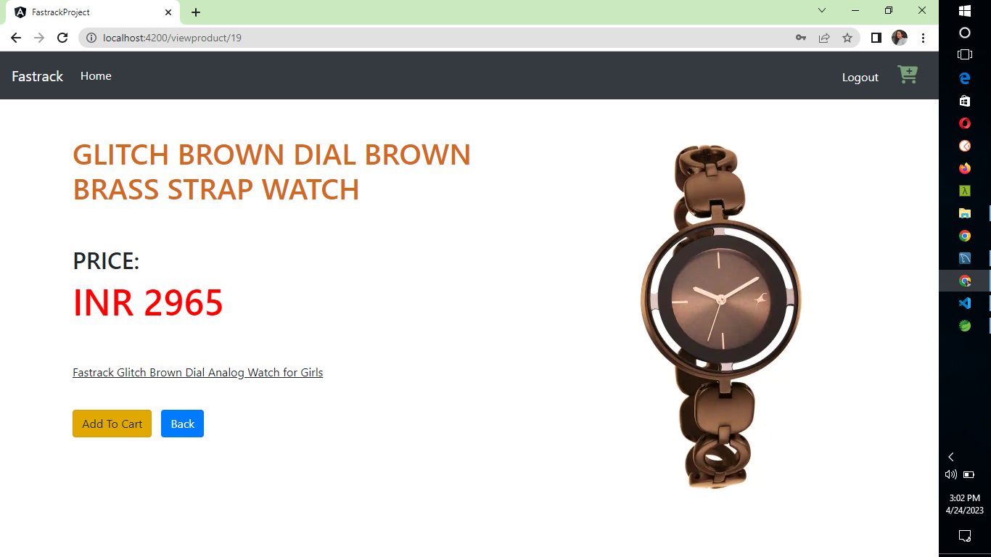
PRODUCT DESCRIPTION AND ADD TO CART OPTION

Slide 8
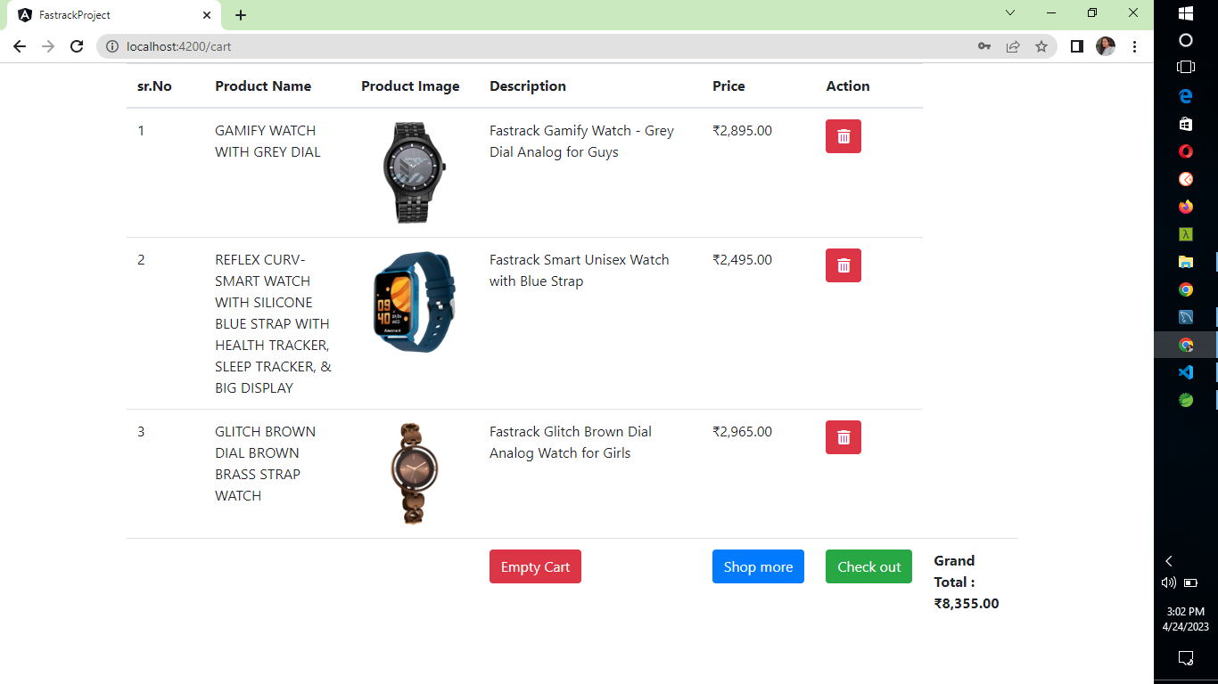
CART PAGE FOR SPECIFIC USER WHO WAS LOGGED IN. CAN EMPTY CART AT ONE CLICK THEN IT SHOWS…

Slide 9
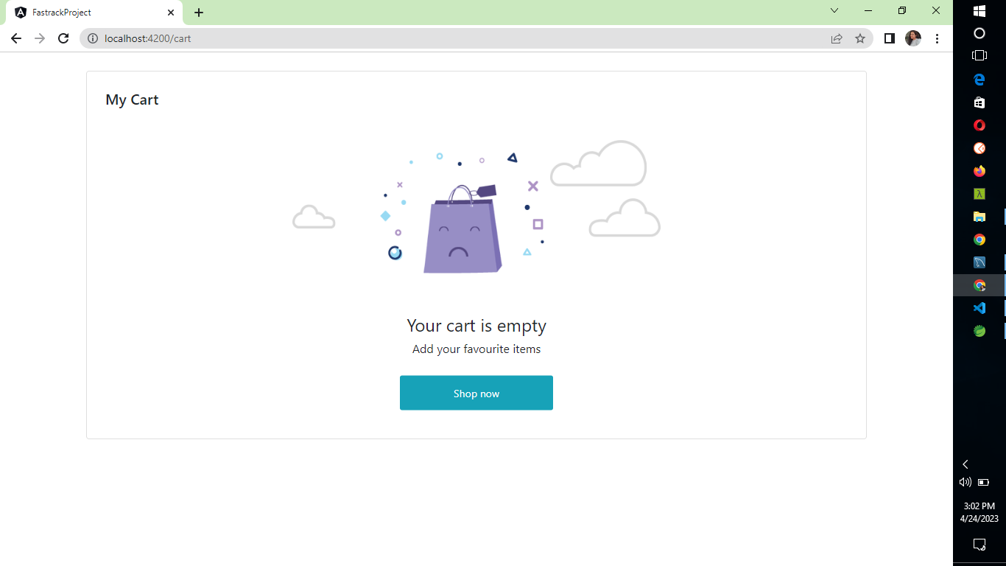
AN EMPTY CART PAGE. FROM WHERE WE CAN REDIRECT TO HOME PAGE.

Slide 10
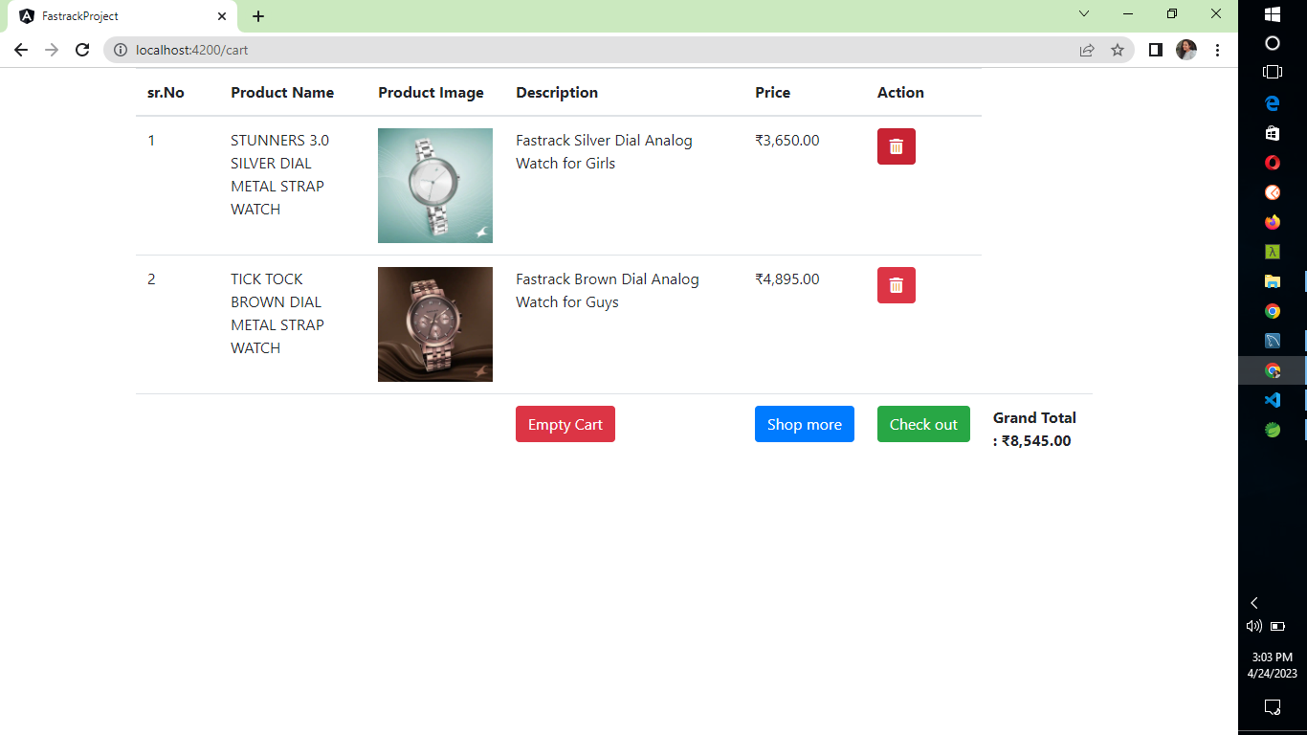
ACTION BUTTON CAN REMOVE PARTICURAL ITEM FROM CART AND UPDATES GRANDTOTAL ALSO.

Slide 11
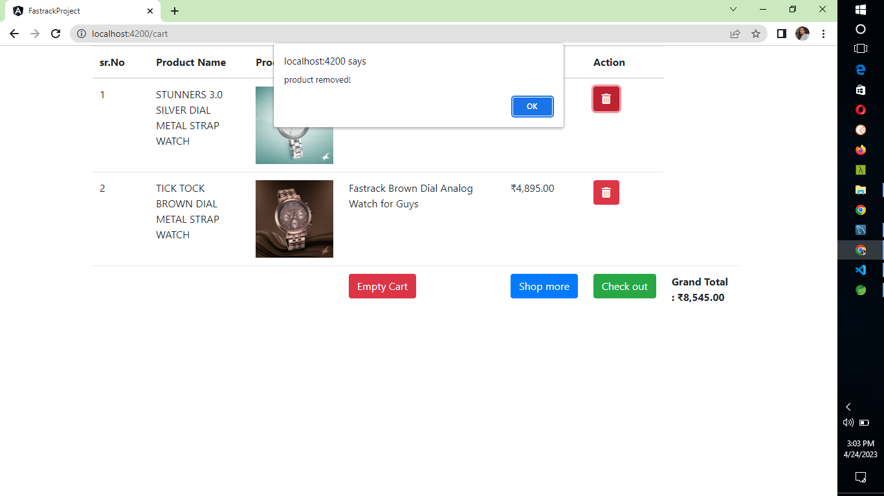
ON SUCCESSFUL REMOVAL OF ITEM. THIS POPUP WILL BE DISPLAYED. ON CLICKING ON CHECKOUT…

Slide 12
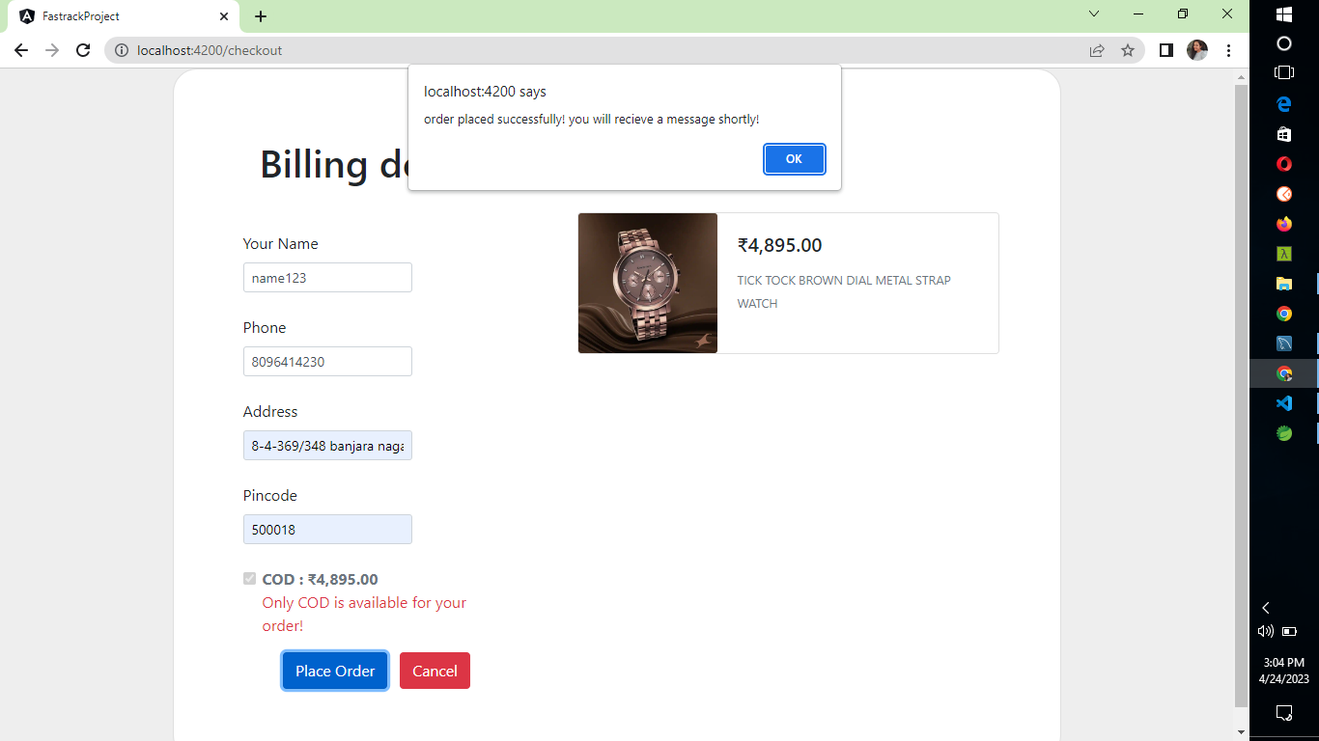
BILLING PAGE WILL BE DISPLAYED. ON SUCCESSFUL PLACE ORDER A POPUP DISPLAYED AND REDIRECTS TO…

Slide 13
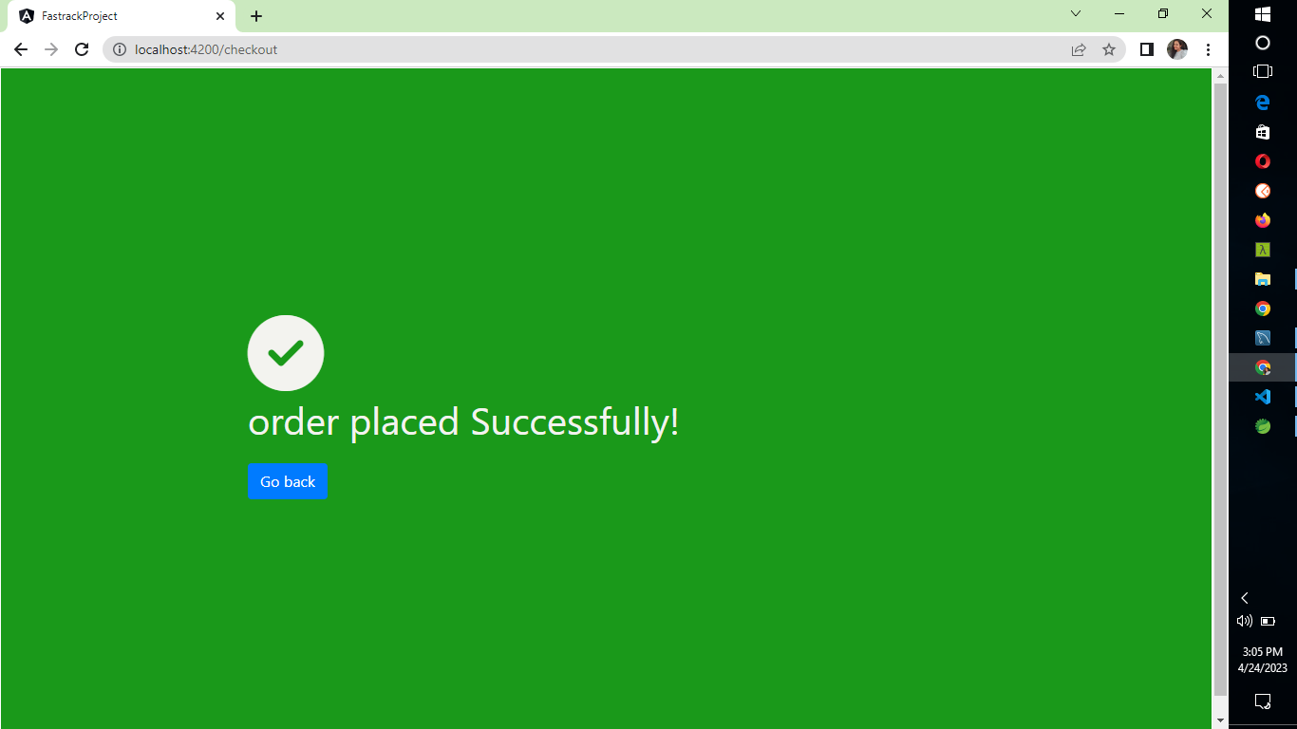
SUCCESSFUL PLACED ORER PAGE

Slide 14
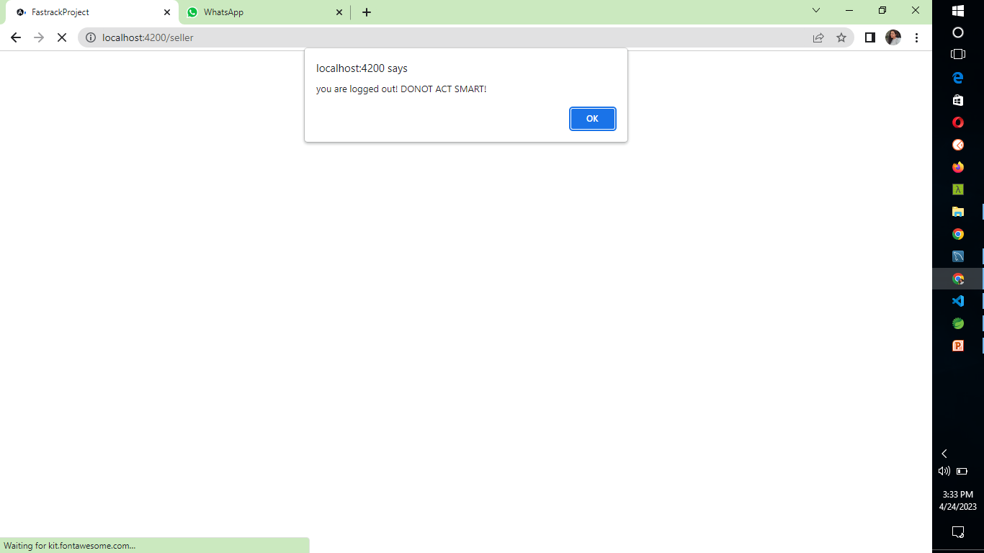
IF TRY TO ACCESS SELLER PAGE FROM URL .THEN IT RESTRICTS AND USER WILL ALSO BE LOGGED OUT

Slide 15
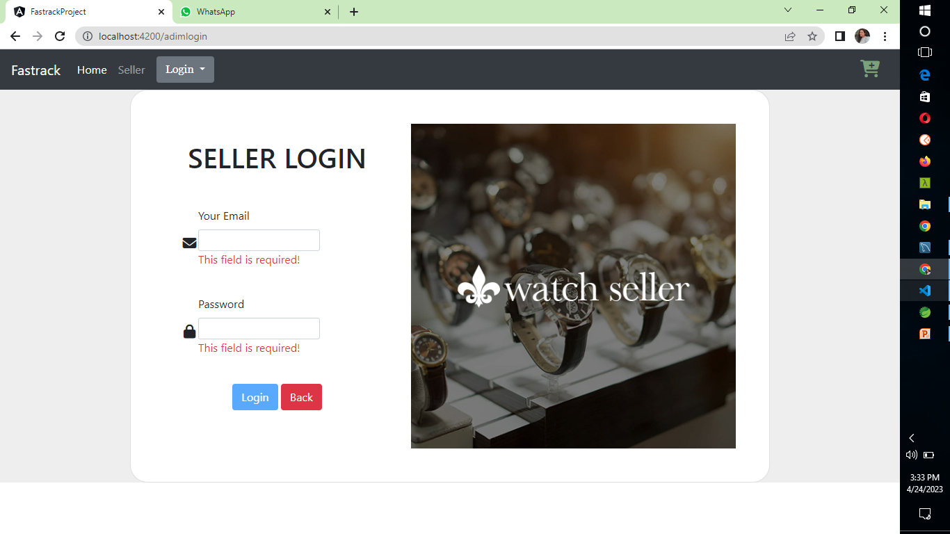
AND ASKS TO LOGIN AS SELLER

Slide 16
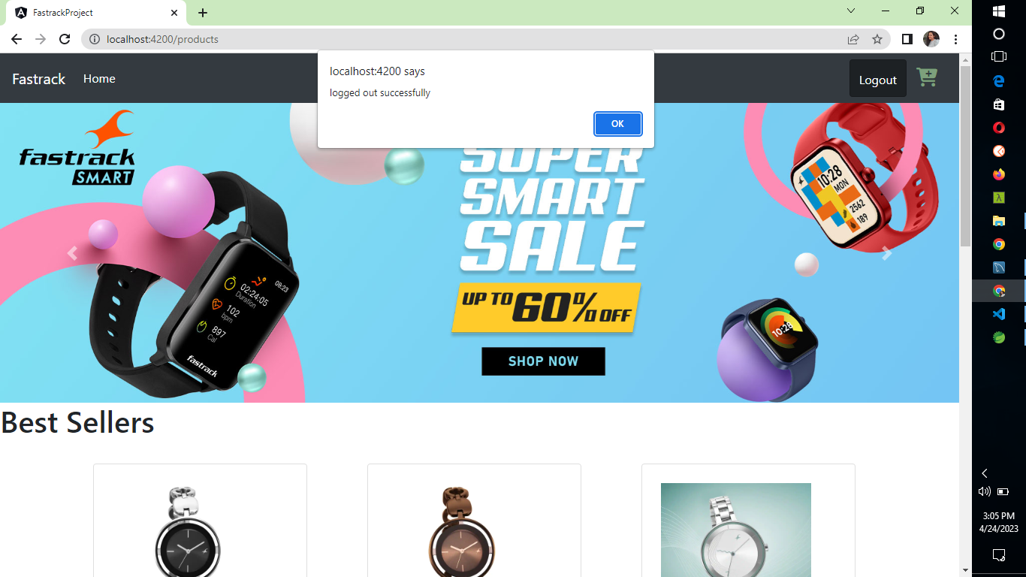
USER LOGOUT OPTION AND ON SUCCESSFUL LOGOUT.

Slide 17
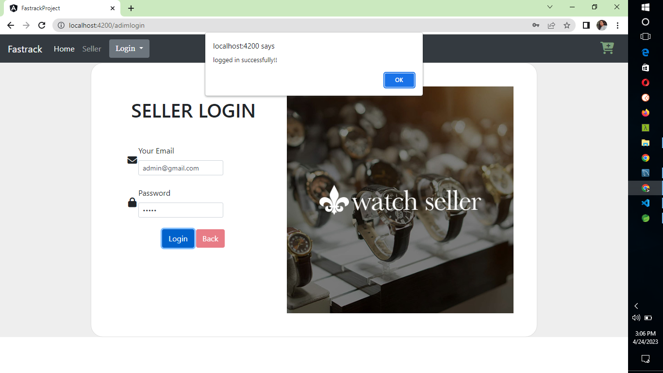
SELLER LOGIN

Slide 18
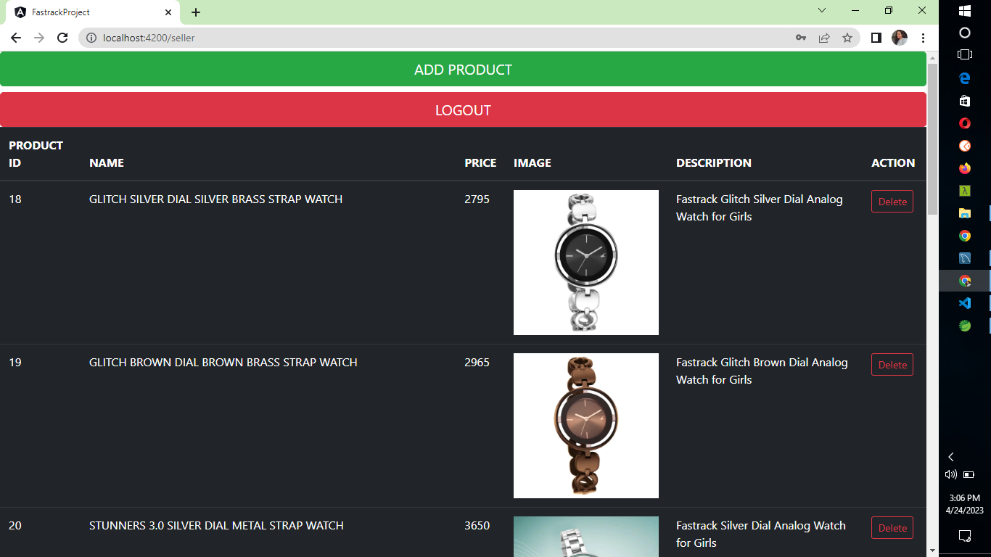
SELLER HOME PAGE

Slide 19
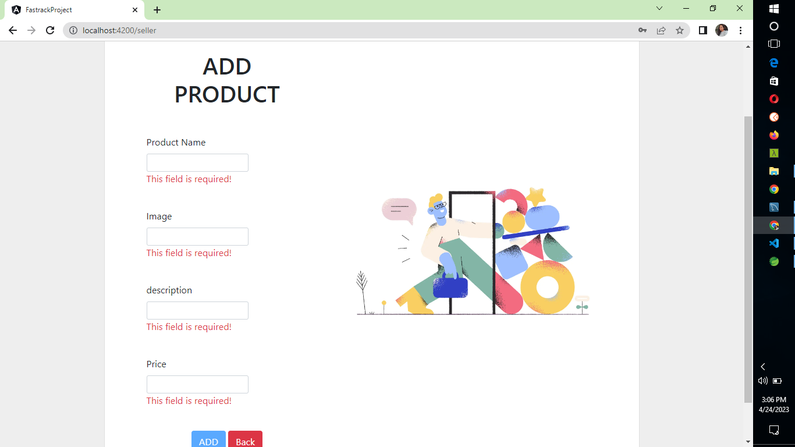
ADDING PRODUCT PAGE

Slide 20
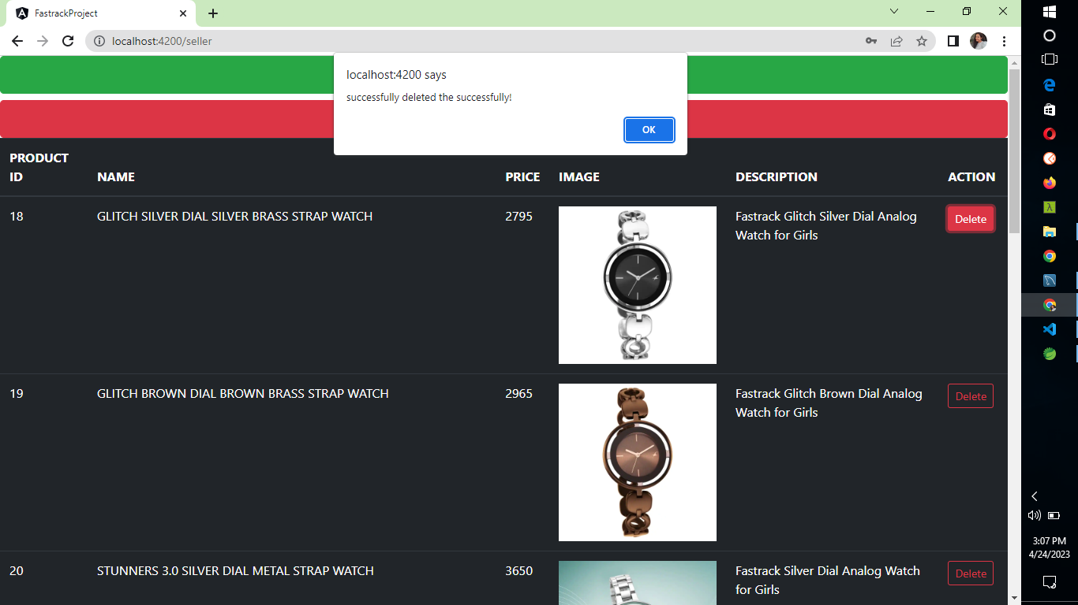
SELLER CAN DELETE THE PRODUCT.

Slide 21
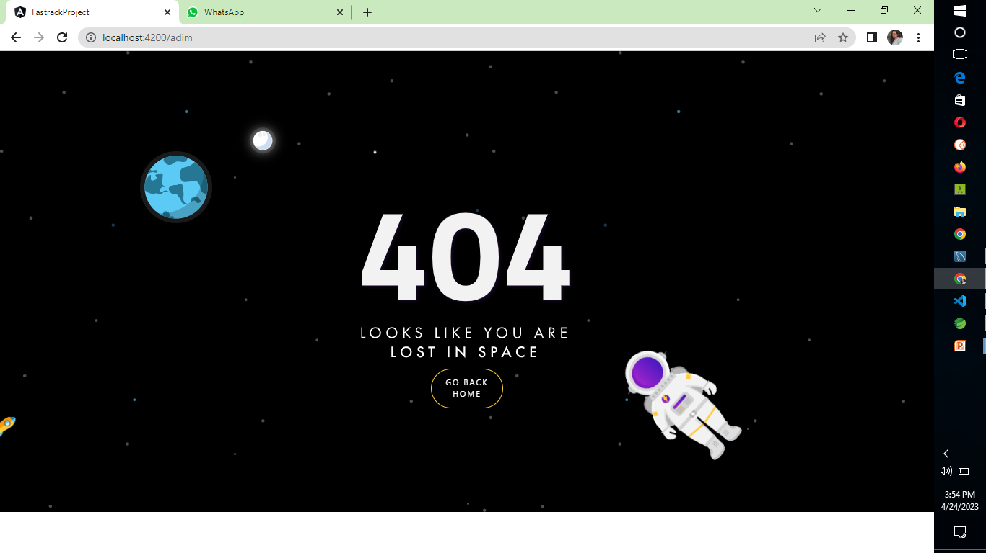
Page not found

